Slide 1


NAME:PRINCY HELAN KAMALIYA
REGISTER/NMD:222407792/autunm1455bscb40
DEPATMENT:B.SC COMPUTER SCIENCE
COLLEGE /UNIVERSITY:TAGORE COLLEGE OF ARTS AND SCIENCE
SCIENCE/UNIVERSITY OF MADRAS

Slide 2
Project Title
Digital Portfolio

Slide 3
AGENDA
1.Program Statement
2.Project Overview
3.End User
4.Tools and techniques
5.Portfoko design and logout
6.Features and Functionality
7.Result and screenshot
8.Conclusion
9.Github link

Slide 4
Got it 👍 You want me to create PowerPoint content (text only) based on your portfolio code, covering the topics you listed. Here’s a structured draft you can directly use to prepare slides: --- Slide 1: Title Slide My Digital Portfolio Problem Statement Students often lack a structured platform to present their skills and projects. Traditional resumes are static and don’t reflect creativity or hands-on abilities. A digital portfolio provides an interactive way to showcase talents and achievements. Developed a responsive web-based portfolio using HTML, CSS, and JavaScript. Includes sections: About Me, Skills, Projects, and Contact. Designed with a modern gradient theme and interactive elements. Acts as a personal branding tool for academic and career opportunities. --- Slide 4: End Users Students – to showcase academic projects and skills. Recruiters & Employers – to evaluate technical skills and creativity. Educators & Mentors – to track students’ growth and guide improvements. Peers & Collaborators – for networking and project sharing. --- Slide 5: Tools & Techniques Frontend Technologies: HTML (Structure) CSS (Design & Styling) JavaScript (Interactivity) Design Principles: Responsive Layout Minimalist and User-friendly UI Version Control: Git/GitHub (optional for deployment). --- Slide 6: Portfolio Design & Layout Header: Title + Navigation Menu. About Me: Profile photo + introduction. Skills Section: Key technical and soft skills. Projects Section: Interactive cards with project descriptions. Contact Section: Email, phone, and clickable button. Footer: Copyright information. --- Slide 7: Features & Functionality Smooth navigation menu with hover effects. Profile picture with circular styling. Interactive project cards (hover animations). Button with JavaScript function to display a message. Responsive design for different devices. Clean and professional look. --- Slide 8: Conclusion The portfolio successfully demonstrates skills, creativity, and projects. Provides a modern digital identity for professional growth. Enhances visibility for recruiters and networking opportunities. Can be further improved with backend integration and live deployment. --- ✨ Do you want me to generate this into a ready-to-use PPT file (.pptx) with proper slide formatting, or do you prefer to keep only the text so you can prepare it manually?

Slide 5
Got it 👍 You want me to create PowerPoint content (text only) based on your portfolio code, covering the topics you listed. Here’s a structured draft you can directly use to prepare slides: --- Slide 1: Title Slide My Digital Portfolio Princy Helan Kamaliya (Year – 2025) --- Slide 2: Problem Statement Students often lack a structured platform to present their skills and projects. Traditional resumes are static and don’t reflect creativity or hands-on abilities. A digital portfolio provides an interactive way to showcase talents and achievements. Project Overview Developed a responsive web-based portfolio using HTML, CSS, and JavaScript. Includes sections: About Me, Skills, Projects, and Contact. Designed with a modern gradient theme and interactive elements. Students – to showcase academic projects and skills. Recruiters & Employers – to evaluate technical skills and creativity. Educators & Mentors – to track students’ growth and guide improvements. Peers & Collaborators – for networking and project sharing. --- Slide 5: Tools & Techniques Frontend Technologies: HTML (Structure) CSS (Design & Styling) JavaScript (Interactivity) Design Principles: Responsive Layout Minimalist and User-friendly UI Version Control: Git/GitHub (optional for deployment). --- Slide 6: Portfolio Design & Layout Header: Title + Navigation Menu. About Me: Profile photo + introduction. Skills Section: Key technical and soft skills. Projects Section: Interactive cards with project descriptions. Contact Section: Email, phone, and clickable button. Footer: Copyright information. --- Slide 7: Features & Functionality Smooth navigation menu with hover effects. Profile picture with circular styling. Interactive project cards (hover animations). Button with JavaScript function to display a message. Responsive design for different devices. Clean and professional look. --- Slide 8: Conclusion The portfolio successfully demonstrates skills, creativity, and projects. Provides a modern digital identity for professional growth. Enhances visibility for recruiters and networking opportunities. Can be further improved with backend integration and live deployment. --- ✨ Do you want me to generate this into a ready-to-use PPT file (.pptx) with proper slide formatting, or do you prefer to keep only the text so you can prepare it manually?

Slide 6
Got it 👍 You want me to create PowerPoint content (text only) based on your portfolio code, covering the topics you listed. Here’s a structured draft you can directly use to prepare slides: --- Slide 1: Title Slide My Digital Portfolio Princy Helan Kamaliya (Year – 2025) --- Slide 2: Problem Statement Students often lack a structured platform to present their skills and projects. Traditional resumes are static and don’t reflect creativity or hands-on abilities. A digital portfolio provides an interactive way to showcase talents and achievements. --- Slide 3: Project Overview Developed a responsive web-based portfolio using HTML, CSS, and JavaScript. Includes sections: About Me, Skills, Projects, and Contact. Designed with a modern gradient theme and interactive elements. Acts as a personal branding tool for academic and career opportunities. Who are the end users Students – to showcase academic projects and skills. Recruiters & Employers – to evaluate technical skills and creativity. Educators & Mentors – to track students’ growth and guide improvements. Slide 5: Tools & Techniques Frontend Technologies: HTML (Structure) CSS (Design & Styling) JavaScript (Interactivity) Design Principles: Responsive Layout Minimalist and User-friendly UI Version Control: Git/GitHub (optional for deployment). --- Slide 6: Portfolio Design & Layout Header: Title + Navigation Menu. About Me: Profile photo + introduction. Skills Section: Key technical and soft skills. Projects Section: Interactive cards with project descriptions. Contact Section: Email, phone, and clickable button. Footer: Copyright information. --- Slide 7: Features & Functionality Smooth navigation menu with hover effects. Profile picture with circular styling. Interactive project cards (hover animations). Button with JavaScript function to display a message. Responsive design for different devices. Clean and professional look. --- Slide 8: Conclusion The portfolio successfully demonstrates skills, creativity, and projects. Provides a modern digital identity for professional growth. Enhances visibility for recruiters and networking opportunities. Can be further improved with backend integration and live deployment. --- ✨ Do you want me to generate this into a ready-to-use PPT file (.pptx) with proper slide formatting, or do you prefer to keep only the text so you can prepare it manually?

Slide 7
Got it 👍 You want me to create PowerPoint content (text only) based on your portfolio code, covering the topics you listed. Here’s a structured draft you can directly use to prepare slides: --- Slide 1: Title Slide My Digital Portfolio Princy Helan Kamaliya (Year – 2025) --- Slide 2: Problem Statement Students often lack a structured platform to present their skills and projects. Traditional resumes are static and don’t reflect creativity or hands-on abilities. A digital portfolio provides an interactive way to showcase talents and achievements. --- Slide 3: Project Overview Developed a responsive web-based portfolio using HTML, CSS, and JavaScript. Includes sections: About Me, Skills, Projects, and Contact. Designed with a modern gradient theme and interactive elements. Acts as a personal branding tool for academic and career opportunities. --- Slide 4: End Users Students – to showcase academic projects and skills. Recruiters & Employers – to evaluate technical skills and creativity. Educators & Mentors – to track students’ growth and guide improvements. Peers & Collaborators – for networking and project sharing. --- Slide 5: Tools & Techniques Frontend Technologies: HTML (Structure) CSS (Design & Styling) JavaScript (Interactivity) Design Principles: Responsive Layout Minimalist and User-friendly UI Version Control: Git/GitHub (optional for deployment). --- Slide 6: Portfolio Design & Layout Header: Title Slide 7: Features & Functionality
Got it 👍 You want me to create PowerPoint content (text only) based on your portfolio code, covering the topics you listed. Here’s a structured draft you can directly use to prepare slides: --- Slide 1: Title Slide My Digital Portfolio Princy Helan Kamaliya (Year – 2025) --- Slide 2: Problem Statement Students often lack a structured platform to present their skills and projects. Traditional resumes are static and don’t reflect creativity or hands-on abilities. A digital portfolio provides an interactive way to showcase talents and achievements. --- Slide 3: Project Overview Developed a responsive web-based portfolio using HTML, CSS, and JavaScript. Includes sections: About Me, Skills, Projects, and Contact. Designed with a modern gradient theme and interactive elements. Acts as a personal branding tool for academic and career opportunities. --- Slide 4: End Users Students – to showcase academic projects and skills. Recruiters & Employers – to evaluate technical skills and creativity. Educators & Mentors – to track students’ growth and guide improvements. Peers & Collaborators – for networking and project sharing. Tools & Techniques Frontend Technologies: HTML (Structure) CSS (Design & Styling) JavaScript (Interactivity) Design Principles: Responsive Layout Minimalist and User-friendly UI Version Control: Git/GitHub (optional for deployment).

Slide 8
Got it 👍 You want me to create PowerPoint content (text only) based on your portfolio code, covering the topics you listed. Here’s a structured draft you can directly use to prepare slides: --- Slide 1: Title Slide My Digital Portfolio Princy Helan Kamaliya (Year – 2025) --- Slide 2: Problem Statement Students often lack a structured platform to present their skills and projects. Traditional resumes are static and don’t reflect creativity or hands-on abilities. A digital portfolio provides an interactive way to showcase talents and achievements. --- Slide 3: Project Overview Developed a responsive web-based portfolio using HTML, CSS, and JavaScript. Includes sections: About Me, Skills, Projects, and Contact. Designed with a modern gradient theme and interactive elements. Acts as a personal branding tool for academic and career opportunities. --- Slide 4: End Users Students – to showcase academic projects and skills. Recruiters & Employers – to evaluate technical skills and creativity. Educators & Mentors – to track students’ growth and guide improvements. Peers & Collaborators – for networking and project sharing. Tools & Techniques Frontend Technologies: HTML (Structure) CSS (Design & Styling) JavaScript (Interactivity) Design Principles: Responsive Layout Minimalist and User-friendly UI Version Control: Git/GitHub (optional for deployment). Portfolio Design & Layout Header: Title + Navigation Menu. About Me: Profile photo + introduction. Skills Section: Key technical and soft skills. Projects Section: Interactive cards with project descriptions. Contact Section: Email, phone, and clickable button. --- Slide 7: Features & Functionality Smooth navigation menu with hover effects. Profile picture with circular styling. Interactive project cards (hover animations). Button with JavaScript function to display a message. Responsive design for different devices. Clean and professional look. --- Slide 8: Conclusion The portfolio successfully demonstrates skills, creativity, and projects. Provides a modern digital identity for professional growth. Enhances visibility for recruiters and networking opportunities. Can be further improved with backend integration and live deployment. --- ✨ Do you want me to generate this into a ready-to-use PPT file (.pptx) with proper slide formatting, or do you prefer to keep only the text so you can prepare it manually?

Slide 9
Got it 👍 You want me to create PowerPoint content (text only) based on your portfolio code, covering the topics you listed. Here’s a structured draft you can directly use to prepare slides: --- Slide 1: Title Slide My Digital Portfolio Princy Helan Kamaliya (Year – 2025) --- Slide 2: Problem Statement Students often lack a structured platform to present their skills and projects. Traditional resumes are static and don’t reflect creativity or hands-on abilities. A digital portfolio provides an interactive way to showcase talents and achievements. --- Slide 3: Project Overview Developed a responsive web-based portfolio using HTML, CSS, and JavaScript. Includes sections: About Me, Skills, Projects, and Contact. Designed with a modern gradient theme and interactive elements. Acts as a personal branding tool for academic and career opportunities. --- Slide 4: End Users Students – to showcase academic projects and skills. Recruiters & Employers – to evaluate technical skills and creativity. Educators & Mentors – to track students’ growth and guide improvements. Peers & Collaborators – for networking and project sharing. --- Slide 5: Tools & Techniques Frontend Technologies: HTML (Structure) CSS (Design & Styling) JavaScript (Interactivity) Design Principles: Responsive Layout Minimalist and User-friendly UI Version Control: Git/GitHub (optional for deployment). Portfolio Design & Layout Header: Title + Navigation Menu. About Me: Profile photo + introduction. Skills Section: Key technical and soft skills. Projects Section: Interactive cards with project descriptions. Contact SectioEmaiphone, and clickable button. Footer: Copyright information. Features & Functionality Smooth navigation menu with hover effects. Profile picture with circular styling. Interactive project cards (hover animations). Button with JavaScript function to display a message. Responsive design for different devices. Clean and professional look. --- Slide 8: Conclusion The portfolio successfully demonstrates skills, creativity, and projects. Provides a modern digital identity for professional growth. Enhances visibility for recruiters and networking opportunities. Can be further improved with backend integration and live deployment. --- ✨ Do you want me to generate this into a ready-to-use PPT file (.pptx) with proper slide formatting, or do you prefer to keep only the text so you can prepare it manually?
Got it 👍 You want me to create PowerPoint content (text only) based on your portfolio code, covering the topics you listed. Here’s a structured draft you can directly use to prepare slides: --- Slide 1: Title Slide My Digital Portfolio Princy Helan Kamaliya (Year – 2025) --- Slide 2: Problem Statement Students often lack a structured platform to present their skills and projects. Traditional resumes are static and don’t reflect creativity or hands-on abilities. A digital portfolio provides an interactive way to showcase talents and achievements. --- Slide 3: Project Overview Developed a responsive web-based portfolio using HTML, CSS, and JavaScript. Includes sections: About Me, Skills, Projects, and Contact. Designed with a modern gradient theme and interactive elements. Acts as a personal branding tool for academic and career opportunities. --- Slide 4: End Users Students – to showcase academic projects and skills. Recruiters & Employers – to evaluate technical skills and creativity. Educators & Mentors – to track students’ growth and guide improvements. Peers & Collaborators – for networking and project sharing. --- Slide 5: Tools & Techniques Frontend Technologies: HTML (Structure) CSS (Design & Styling) JavaScript (Interactivity) Design Principles: Responsive Layout Minimalist and User-friendly UI Version Control: Git/GitHub (optional for deployment). --- Slide 6: Portfolio Design & Layout Header: Title + Navigation Menu. About Me: Profile photo + introduction. Skills Section: Key technical and soft skills. Projects Section: Interactive cards with Enhances visibility for recruiters and networking opportunities. Can be further improved with backend integration and live deployment. --- ✨ Do you want me to generate this into a ready-to-use PPT file (.pptx) with proper slide formatting, or do you prefer to keep only the text so you can prepare it manually?
Got it 👍 You want me to create PowerPoint content (text only) based on your portfolio code, covering the topics you listed. Here’s a structured draft you can directly use to prepare slides: --- Slide 1: Title Slide My Digital Portfolio Princy Helan Kamaliya (Year – 2025) --- Slide 2: Problem Statement Students often lack a structured platform to present their skills and projects. Traditional resumes are static and don’t reflect creativity or hands-on abilities. A digital portfolio provides an interactive way to showcase talents and achievements. --- Slide 3: Project Overview Developed a responsive web-based portfolio using HTML, CSS, and JavaScript. Includes sections: About Me, Skills, Projects, and Contact. Designed with a modern gradient theme and interactive elements. Acts as a personal branding tool for academic and career opportunities. --- Slide 4: End Users Students – to showcase academic projects and skills. Recruiters & Employers – to evaluate technical skills and creativity. Educators & Mentors – to track students’ growth and guide improvements. Peers & Collaborators – for networking and project sharing. --- Slide 5: Tools & Techniques Frontend Technologies: HTML (Structure) CSS (Design & Styling) JavaScript (Interactivity) Design Principles: Responsive Layout Minimalist and User-friendly UI Version Control: Git/GitHub (optional for deployment). --- Slide 6: Portfolio Design & Layout Header: Title + Navigation Menu. About Me: Profile photo + introduction. Skills Section: Key technical and soft skills. Projects Section: Interactive cards with Enhances visibility for recruiters and networking opportunities. Can be further improved with backend integration and live deployment. --- ✨ Do you want me to generate this into a ready-to-use PPT file (.pptx) with proper slide formatting, or do you prefer to keep only the text so you can prepare it manually?
Got it 👍 You want me to create PowerPoint content (text only) based on your portfolio code, covering the topics you listed. Here’s a structured draft you can directly use to prepare slides: --- Slide 1: Title Slide My Digital Portfolio Princy Helan Kamaliya (Year – 2025) --- Slide 2: Problem Statement Students often lack a structured platform to present their skills and projects. Traditional resumes are static and don’t reflect creativity or hands-on abilities. A digital portfolio provides an interactive way to showcase talents and achievements. --- Slide 3: Project Overview Developed a responsive web-based portfolio using HTML, CSS, and JavaScript. Includes sections: About Me, Skills, Projects, and Contact. Designed with a modern gradient theme and interactive elements. Acts as a personal branding tool for academic and career opportunities. --- Slide 4: End Users Students – to showcase academic projects and skills. Recruiters & Employers – to evaluate technical skills and creativity. Educators & Mentors – to track students’ growth and guide improvements. Peers & Collaborators – for networking and project sharing. --- Slide 5: Tools & Techniques Frontend Technologies: HTML (Structure) CSS (Design & Styling) JavaScript (Interactivity) Design Principles: Responsive Layout Minimalist and User-friendly UI Version Control: Git/GitHub (optional for deployment). --- Slide 6: Portfolio Design & Layout Header: Title + Navigation Menu. About Me: Profile photo + introduction. Skills Section: Key technical and soft skills. Projects Section: Interacti Enhances visibility for recruiters and networking opportunities. Can be further improved with backend integration and live deployment. --- ✨ Do you want me to generate this into a ready-to-use PPT file (.pptx) with proper slide formatting, or do you prefer to keep only the text so you can prepare it manually?

Slide 10
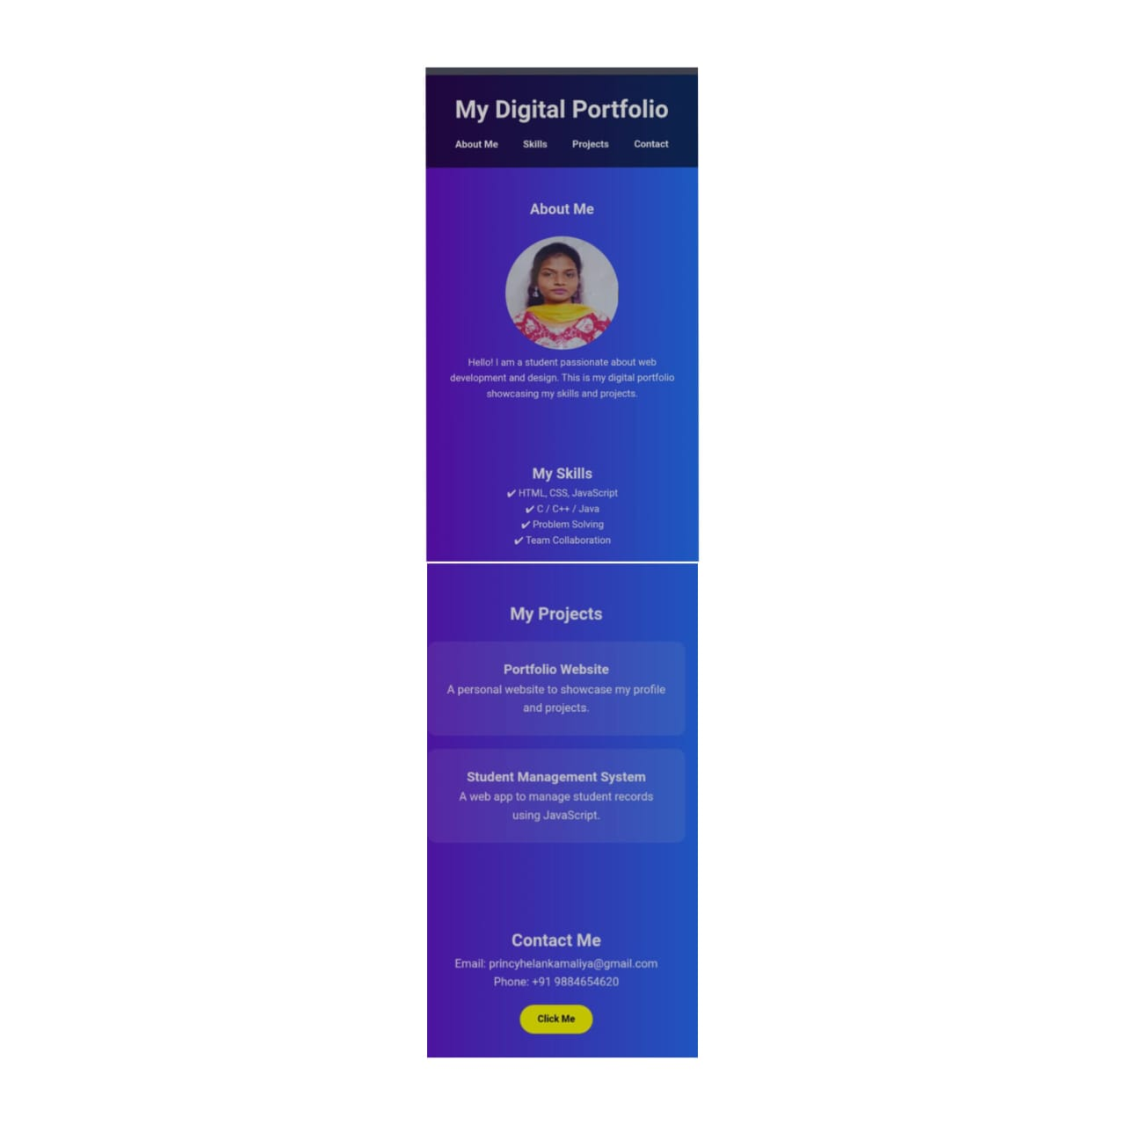
Results and screenshots

Slide 11
Got it 👍 You want me to create PowerPoint content (text only) based on your portfolio code, covering the topics you listed. Here’s a structured draft you can directly use to prepare slides: --- Slide 1: Title Slide My Digital Portfolio Princy Helan Kamaliya (Year – 2025) --- Slide 2: Problem Statement Students often lack a structured platform to present their skills and projects. Traditional resumes are static and don’t reflect creativity or hands-on abilities. A digital portfolio provides an interactive way to showcase talents and achievements. --- Slide 3: Project Overview Developed a responsive web-based portfolio using HTML, CSS, and JavaScript. Includes sections: About Me, Skills, Projects, and Contact. Designed with a modern gradient theme and interactive elements. Acts as a personal branding tool for academic and career opportunities. --- Slide 4: End Users Students – to showcase academic projects and skills. Recruiters & Employers – to evaluate technical skills and creativity. Educators & Mentors – to track students’ growth and guide improvements. Peers & Collaborators – for networking and project sharing. --- Slide 5: Tools & Techniques Frontend Technologies: HTML (Structure) CSS (Design & Styling) JavaScript (Interactivity) Design Principles: Responsive Layout Minimalist and User-friendly UI Version Control: Git/GitHub (optional for deployment). --- Slide 6: Portfolio Design & Layout Header: Title + Navigation Menu. About Me: Profile photo + introduction. Skills Section: Key technical and soft skills. Projects Section: Interactive cards with project descriptions. Contact Section: Email, phone, and clickable button. Footer: Copyright information. --- Slide 7: Features & Functionality Smooth navigation menu with hover effects. Profile picture with circular styling. Interactive project cards (hover animations). Button with JavaScript function to display a message. Responsive design for different devices. Clean and professional look. Conclusion The portfolio successfully demonstrates skills, creativity, and projects. Provides a modern digital identity for professional growth. Enhances visibility for recruiters and networking opportunities. Can be further improved with backend integration and live deployment. --- ✨ Do you want me to generate this into a ready-to-use PPT file (.pptx) with proper slide formatting, or do you prefer to keep only the text so you can prepare it manually?

